Slide 1

Online Exam scheduler
A HEMANTH
Axis8JFSB803

Slide 2

Agenda
PROBLEM STATEMENT
INTRODUCTION
PROPOSED SYSTEM
SYSTEM DESIGN
MODULES
REQUIREMENTS
OUTPUT SCREENS

Slide 3
PROBLEM Statement
To get the Student Exam details like Student Id, Name, Exam location and Centre, Exam date and Timings, Room number and Sitting number through Student Id.

Slide 4

Introduction
Now a days it is difficult to know about student exam centre, room number and student details at college notice board. Instead of that just we enter the Student id in this web application then the student will get all the details like Student Id, Name, Exam location and centre, Exam date and Timings, Room number and Sitting number

Slide 5
PROPOSED SYSTEM

Slide 6
In our Proposed system, Student should be login with his credentials.
Once Login done it will redirect into the home page.
Home page consisting of dashboard which can helps to get the student details.
Student should be entering his student Id then he will get all the details.
Another feature Admin can be able to main all the details which is related students and admin.

Slide 7

SYSTEM DESIGN

Slide 8
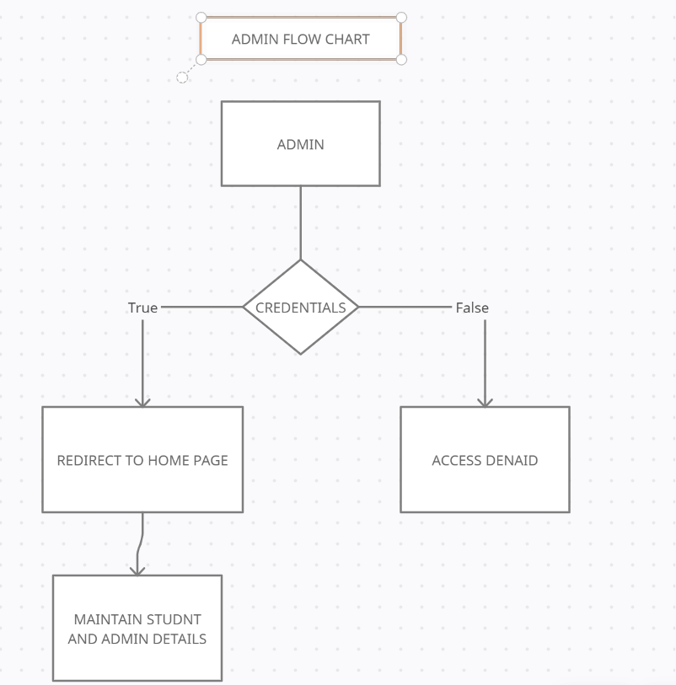
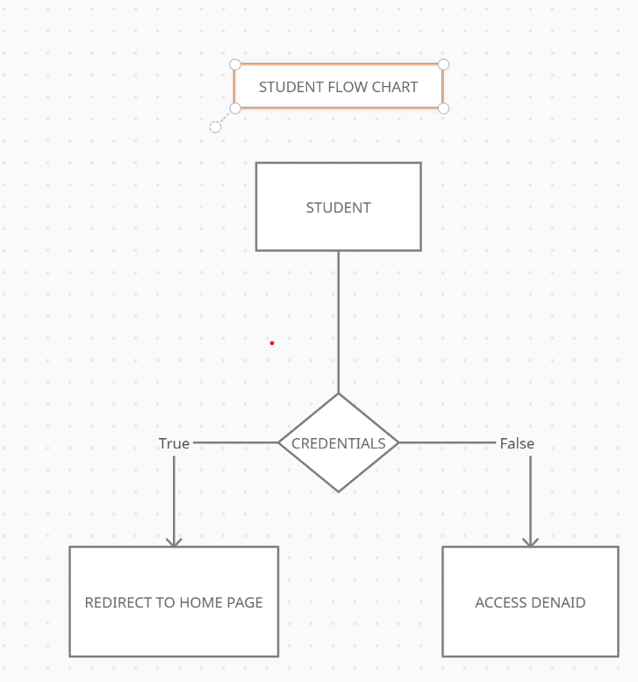

Slide 9

Modules
Student Signup and Login
Admin Login and Maintenance
Student details

Slide 10
Student Signup and Login
Student can able to login through his credentials, if the student doesn’t have account he can able to create.

Slide 11
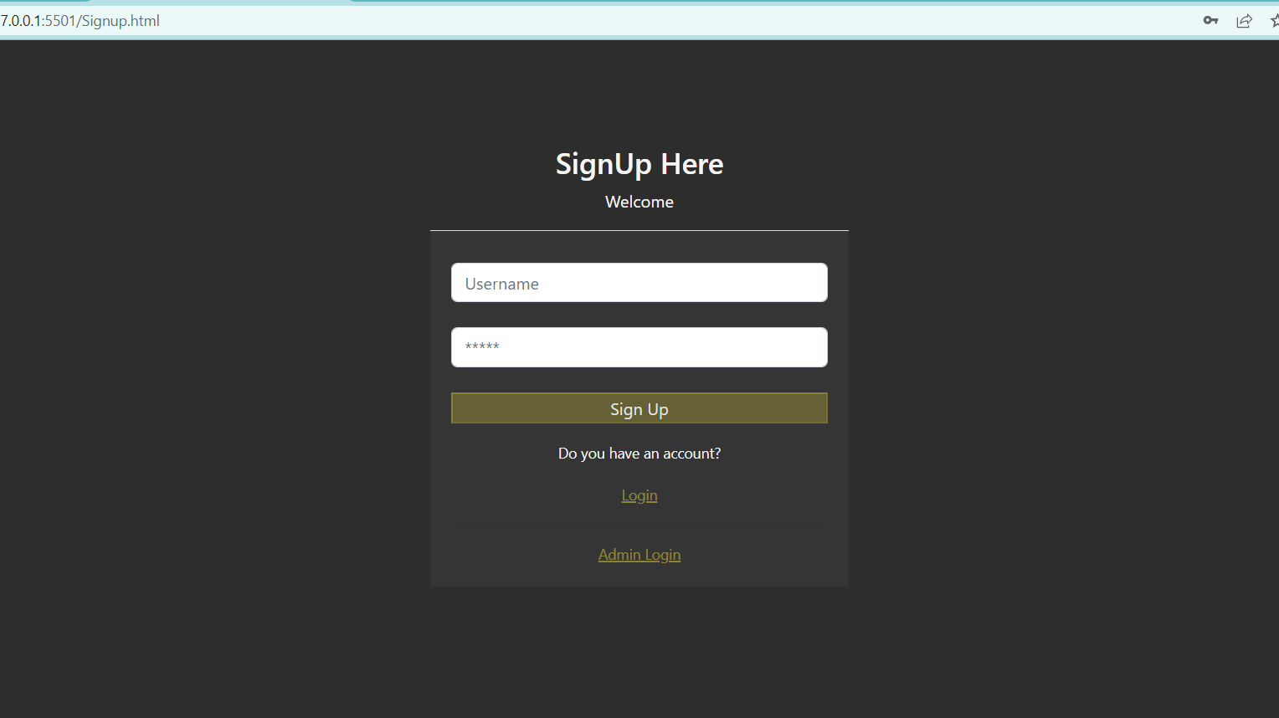
Signup page.

Slide 12

Admin Login and Maintenance
Admin can login into the website and he can able to handle student credentials, student details and admin details as shown in below

Slide 13
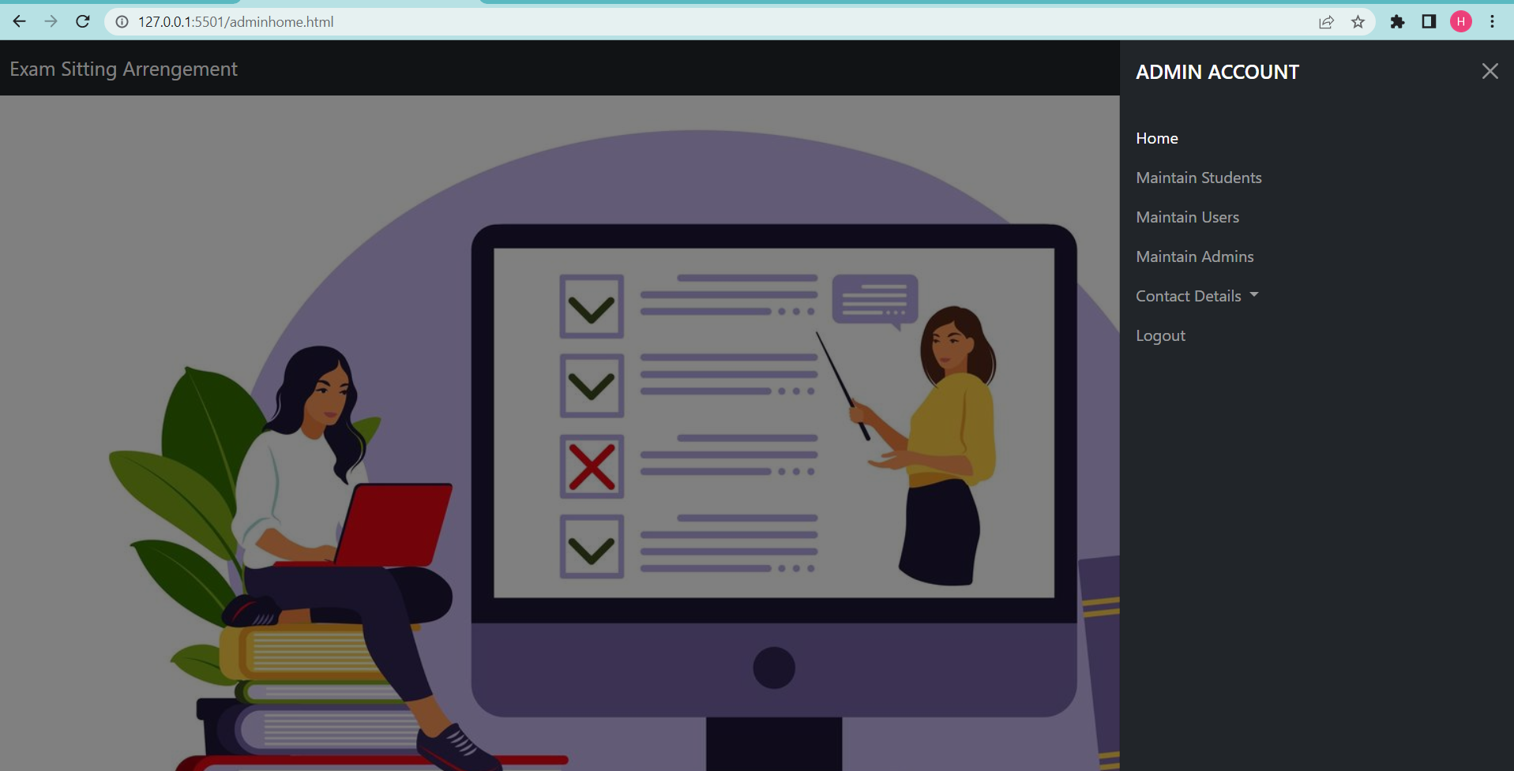

Slide 14
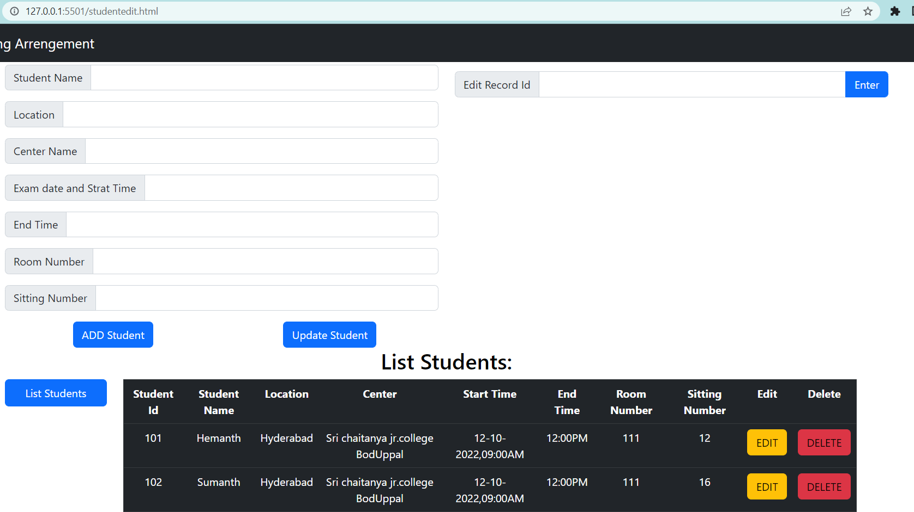
Maintain Student Details

Slide 15
Student details
Student can able to check his details.

Slide 16
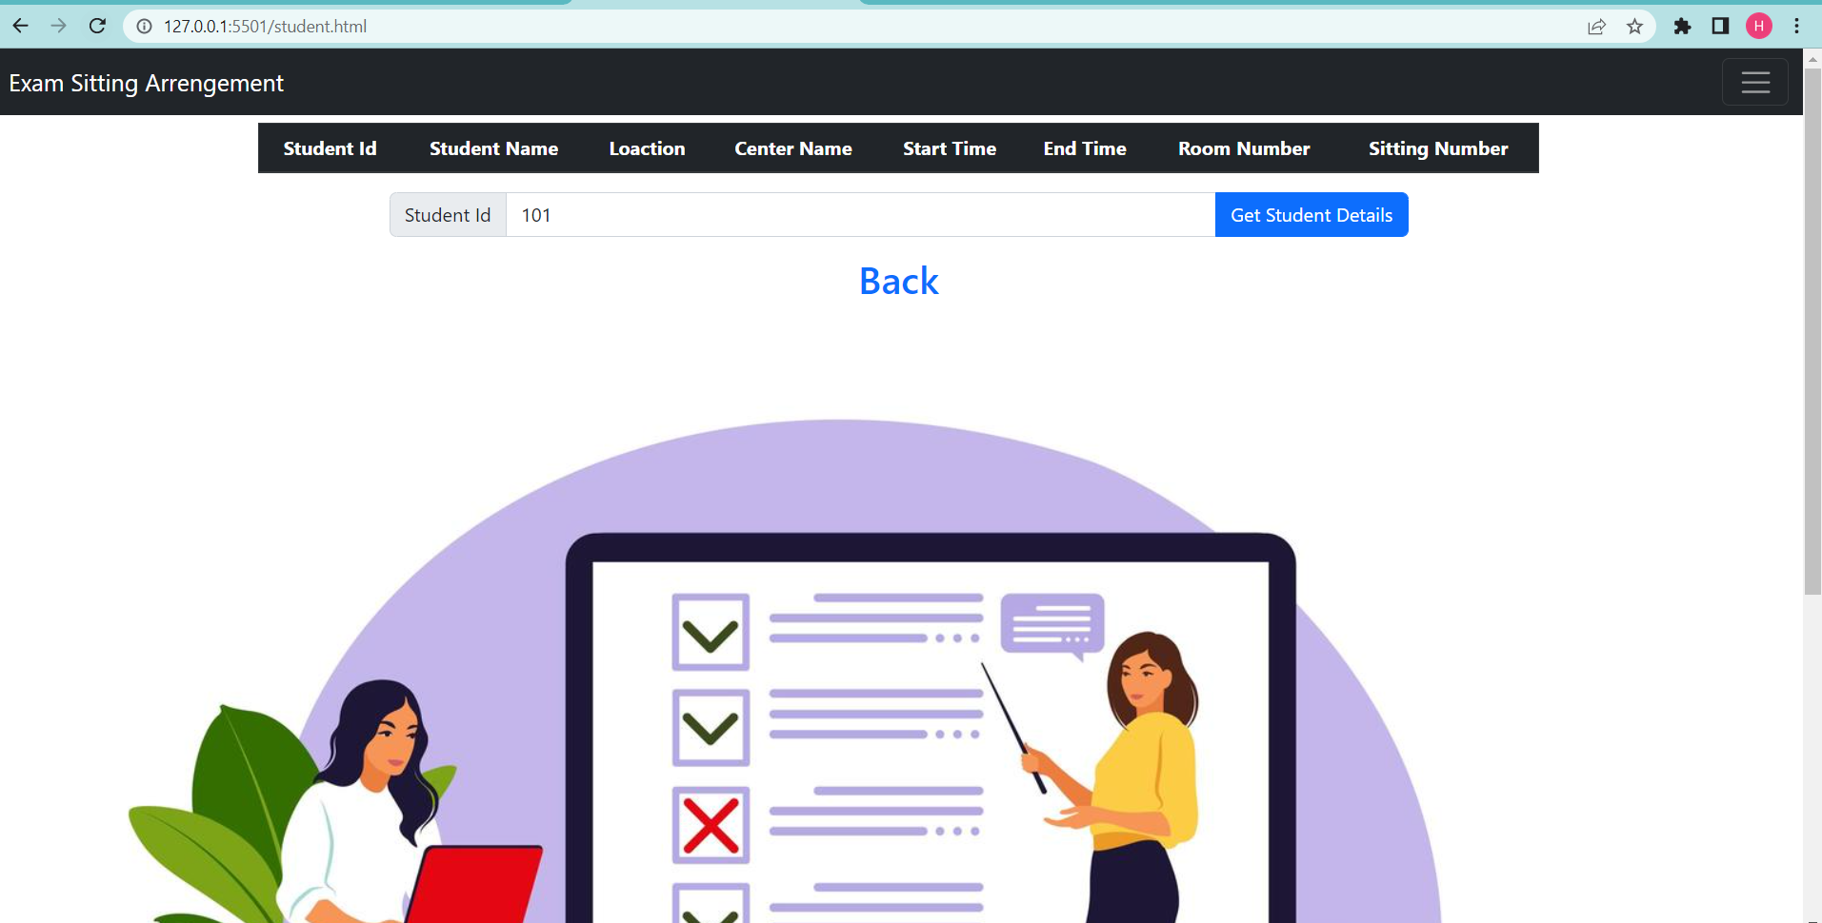
Student details

Slide 17
Software and Hardware requirements
SOFTWARE REQUIREMENTS:
JAVA
SPRING BOOT MICROSERVICES
MYSQL
HTML,CSS,BOOTSTRAP AND JAVASCRIPT
INTELLIJ IDE
CHROME BROWSER
VS CODE
HARDWARE REQUIREMENTS:
RAM-8GB
PROCESSOR-I3
INTERNET

Slide 18
OUTPUT SCREENS

Slide 19
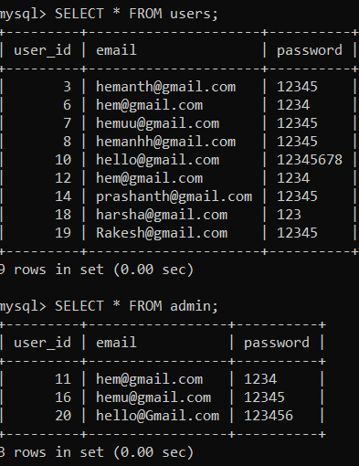
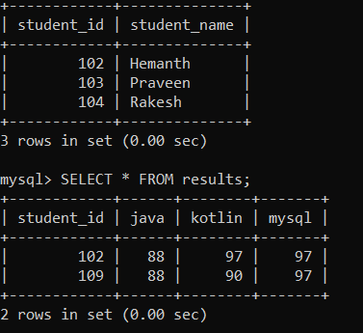
Models

Slide 20
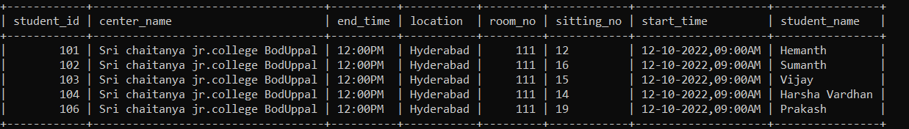
Students-details model

Slide 21
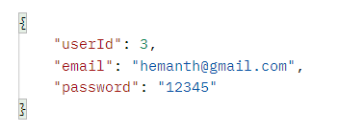
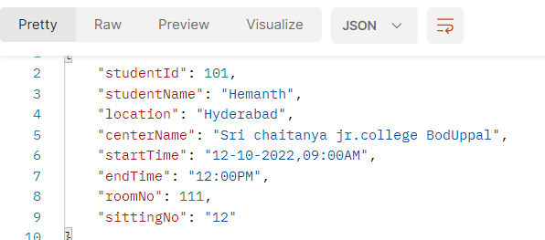
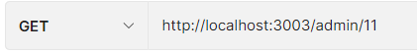
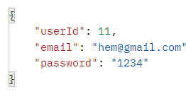
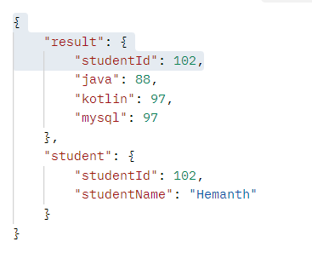
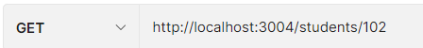
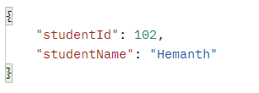
API Testing with postman

Slide 22
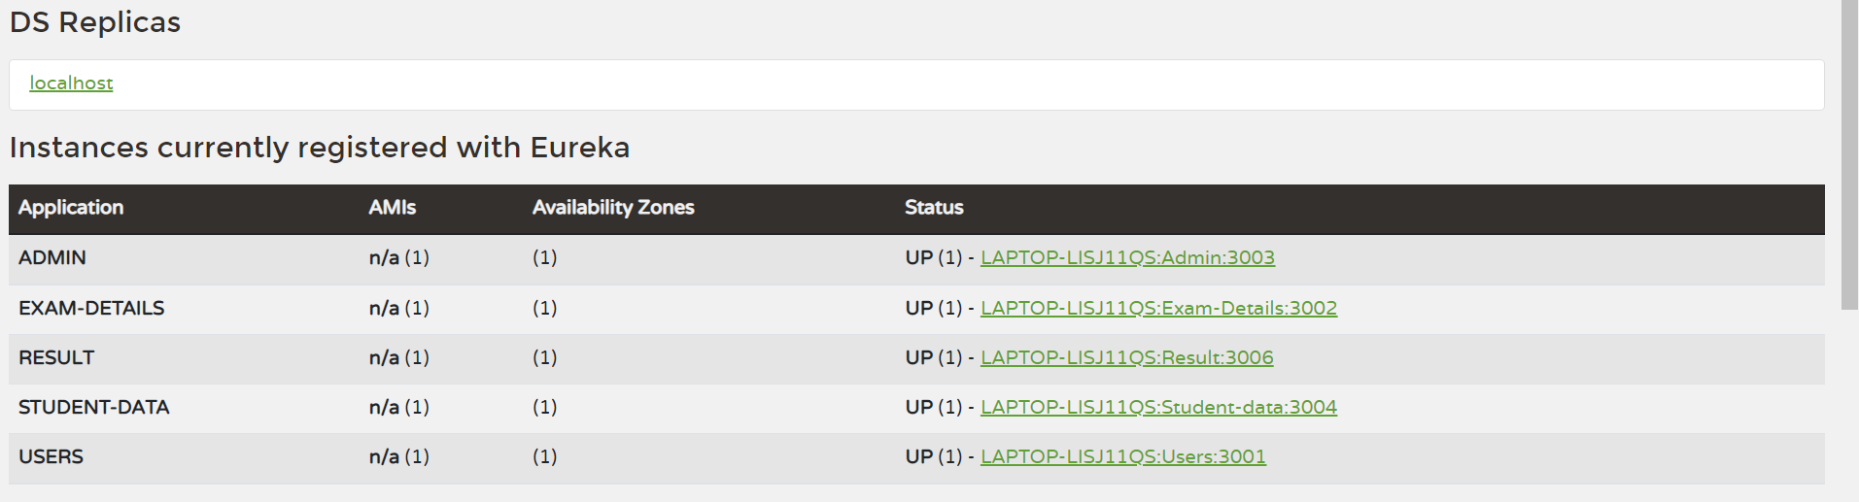
Eureka server

Slide 23




Thank you
A Hemanth
Axis8JFSB803

